Slide 1
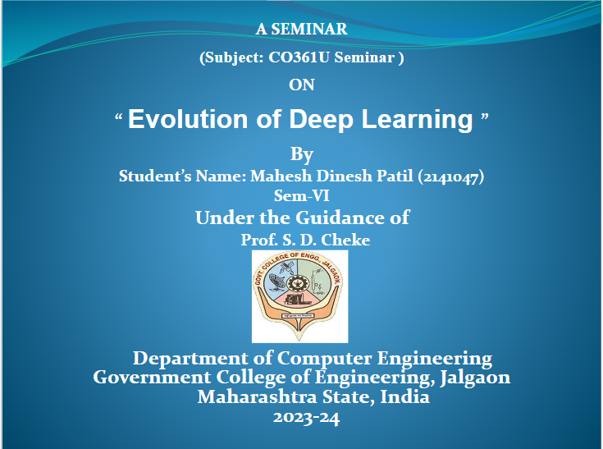

Slide 2
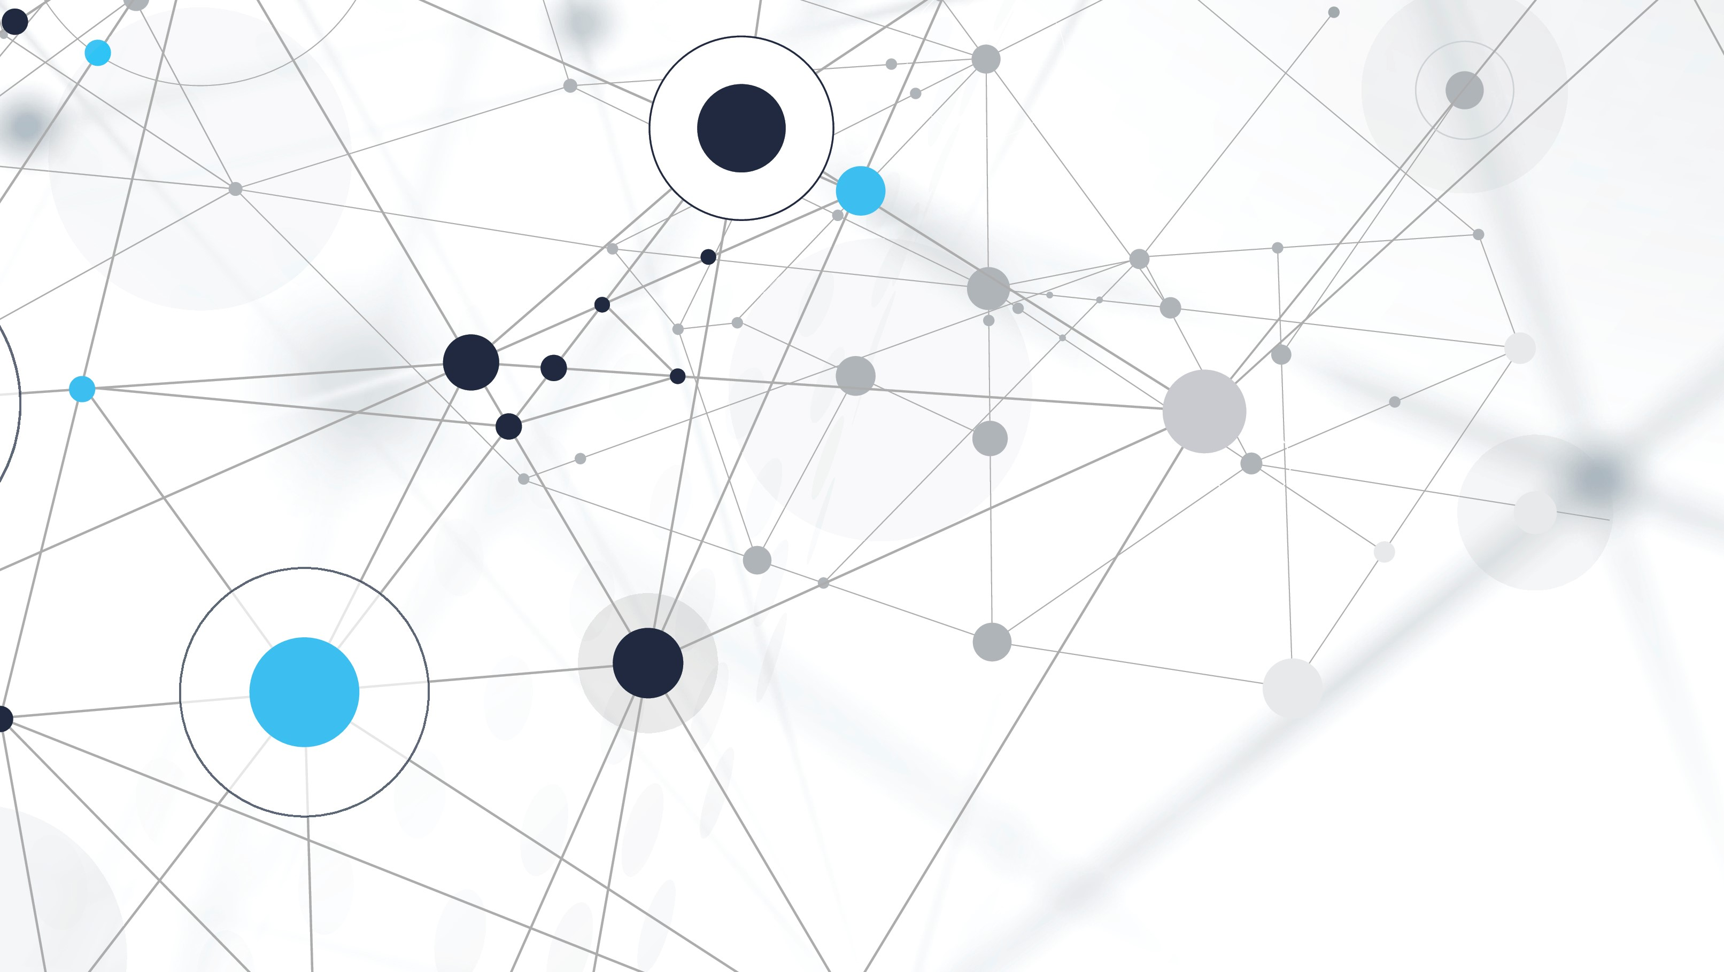
Evolution of Deep Learning A Journey Towards Advancements and Opportunities
By Mahesh D Patil

Slide 3
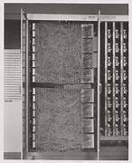
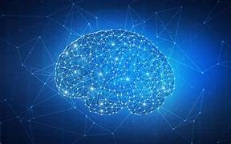
Contents
History of deep learning
Neural networks in deep learning
Future applications

Slide 4
What is Deep Learning ?
Subfield of machine learning.
Inspired by the structure and function of the human brain.
A Transformative Force in Artificial Intelligence (AI) research and applications.
surpassed traditional ML approaches in numerous domains.
ability to learn from massive datasets has fueled its widespread adoption across industries, including healthcare, finance, and automotive.

Slide 5
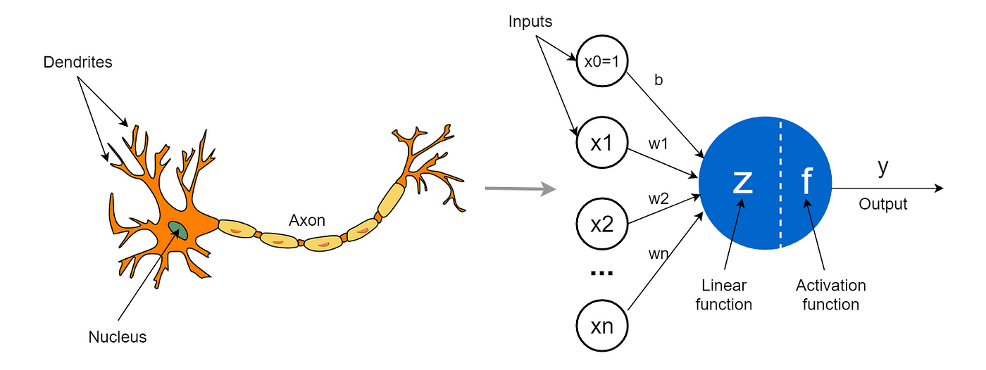
1943: Concept of Artificial Neural Networks (ANNs) Introduced by McCulloch-Pitts model
Inspiration of Neural Network

Slide 6
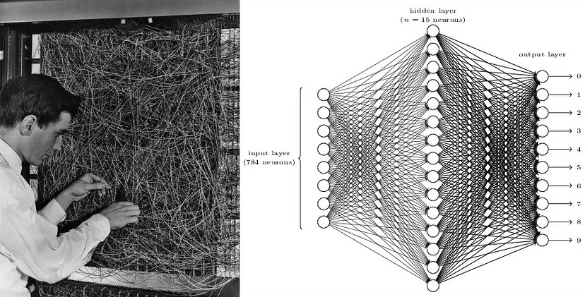
History of Deep Learning
1950s-1960s: Introduction of Perceptrons by Frank Rosenblatt
Contributed to early developments in machine learning and pattern recognition.
Can Only Solve Linear Regression Problem

Slide 7
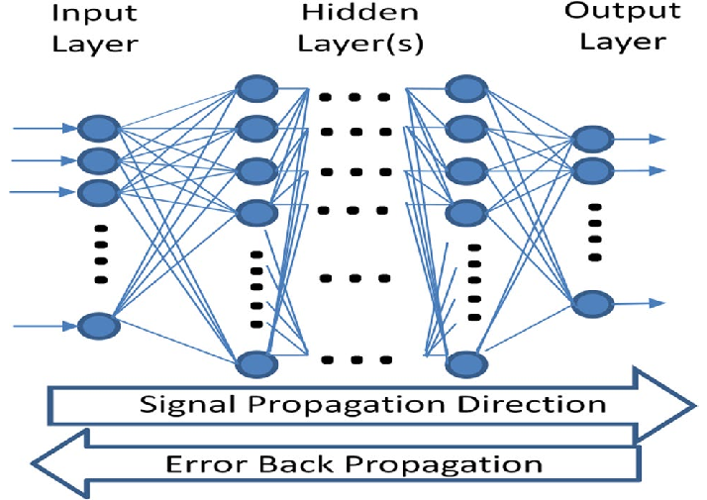
Rediscovery of Backpropagation:
1986: The rediscovery and popularization of the backpropagation algorithm by Geoffrey Hinton
Revolutionized neural network training.
Backpropagation enabled efficient training of multi-layer neural networks

Slide 8
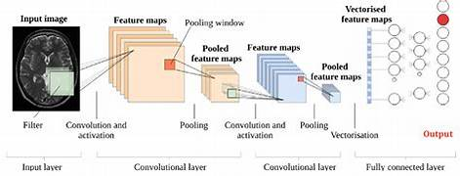
Emergence of Deep Architectures
1989: Yann LeCun introduce LeNet-5
LeNet-5 demonstrated the effectiveness of deep learning in pattern recognition tasks
Deeper neural network architectures featuring multiple layers of neurons.

Slide 9
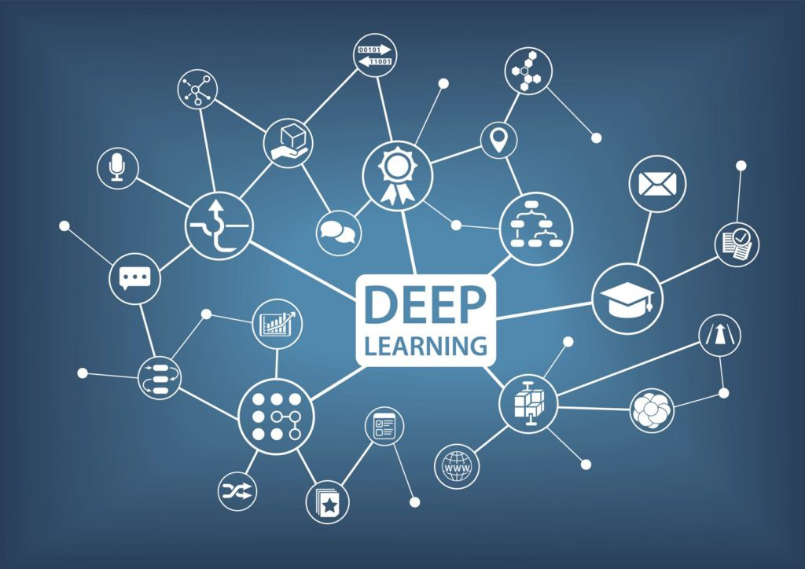
The birth of deep learning
2006: Geoffrey Hinton and others propose the deep belief network (DBN) architecture
This DBNs was able to perform tasks such as image recognition and natural language processing.
This network Brought revolution in both Image and Natural language Processing

Slide 10
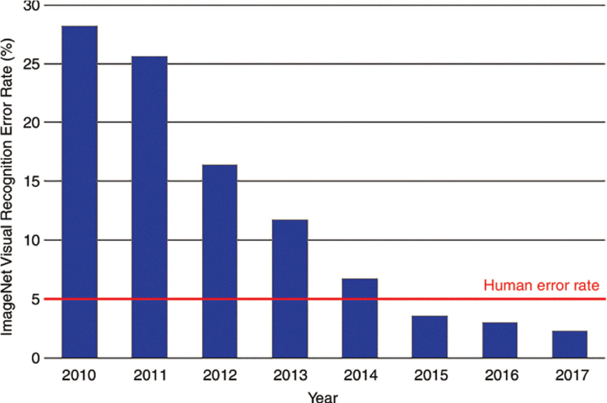
Golden era of deep Learning
2012: Geoffrey Hinton and Team Introduce AlexNet, a deep convolutional neural network architecture
2015: The release of deep learning frameworks such as TensorFlow and PyTorch by Google and Facebook
2016: DeepMind's AlphaGo defeated world champion Go player Lee Sedol

Slide 11
Networks in Deep Learning
CNN
Image Processing
RNN
Natural Language Processing
GAN
Generative AI

Slide 12
Current Work and Research Area in Deep Learning
Automotive and Transportation
Natural Language Processing (NLP)
Speech Recognition and Synthesis
Healthcare and Medical Imaging
Financial Services
Image and Object Recognition

Slide 13
Challenges and Limitations:
The Need for large labeled Datasets
Susceptibility to Adversarial Attacks
Interpretability issues
BlackBox Mechanism

Slide 14
Conclusion :
In conclusion, the evolution of deep learning represents a testament to human ingenuity and innovation. But ,as we continue to push the boundaries of artificial intelligence, let us remain vigilant in addressing ethical concerns and ensuring that these technologies serve the greater good.

Slide 15

Thank You

